Slide 1

Super Information
Manav Mishra
Jai Kumar
[R. Bose and S. Chouhan, Alternate measure of information useful for DNA sequences. Physical Review E 83, 051918 (2011)]

Slide 2

Motivation for Super Information
Shannon Entropy
Shannon Entropy is the measure of information of a random variable. Its defined as:
Randomness implies a higher information content.
But in computing the frequencies of bases in a sequence, we do not take the position of the bases into account.
This is a serious limitation in the definition of Shannon entropy. Need to look for new ways to define randomness.
This is where the role of Super-Information comes up!

Slide 3
Super-Information
What is Super-Information?
Speaking of it in crude terms, it is simply the measure of “entropy of entropies”!
Intuitively, Super information represents the variation in the entropy content of different portions of a given sequence.
If there is a large variation in the entropy of different segments, the super information will be higher.

Slide 4


Definition of Super-Information
Let us divide the entire sequence of symbols, X into N blocks of length B each. Let’s call the ith sequence X_{i} and the shannon entropy associated with it as H(X_{i}) .
Construct the histogram of H(X_{i}), i.e
H_{j} (X_{i},M) = histogram ({H(X_{i})}) i=1,2.....N j=1,2…..M (M is the bin size, taken as 10)
Where, {H_{j} (X_{i},M)} is the number of element in jth element.
Normalise the H_{j} to get the probabilities.
Super-Information is defined as :

Slide 5
Analysis of coding and non-coding region
We have used super information as a mathematical tool to study the coding and noncoding regions of DNA.
We have taken the different prokaryotic genomes as our data for this analysis.
We plotted the plot of H_{s} versus the B value to see if we can get some interesting results!
What we observe is that H_{s}(B,M) has a maximum for certain values of B.
B ∈ (80, 100) gives the max value for most cases. Hence, we fix B=90

Slide 6
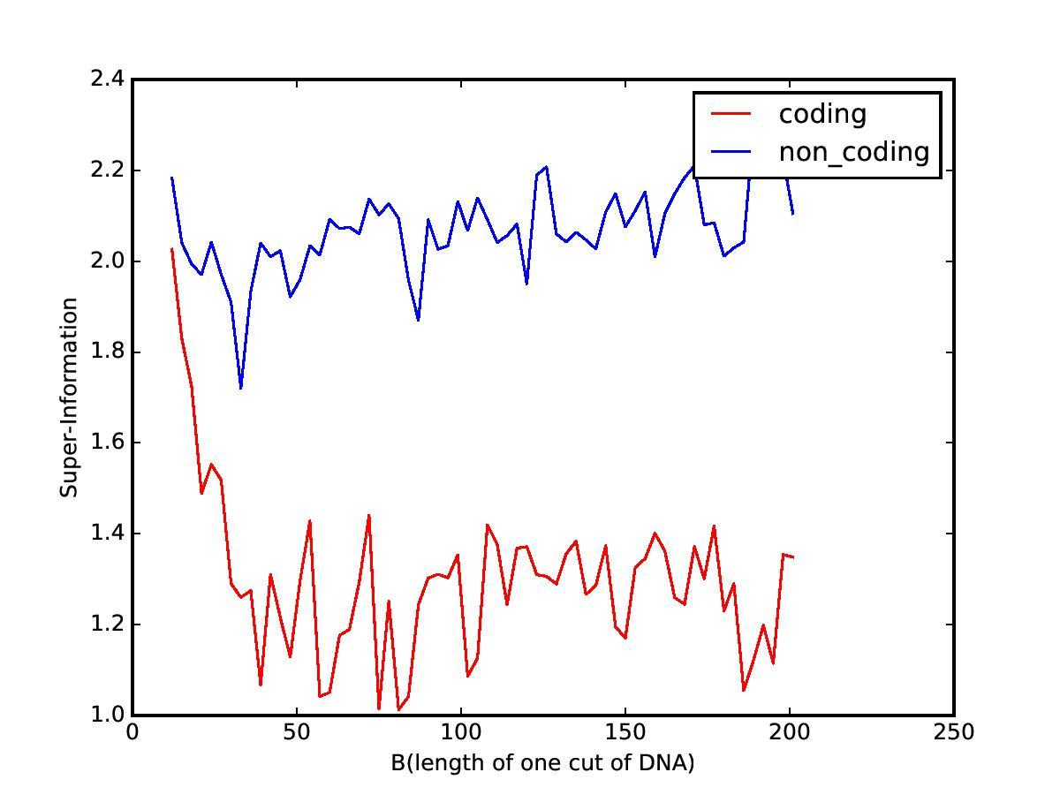
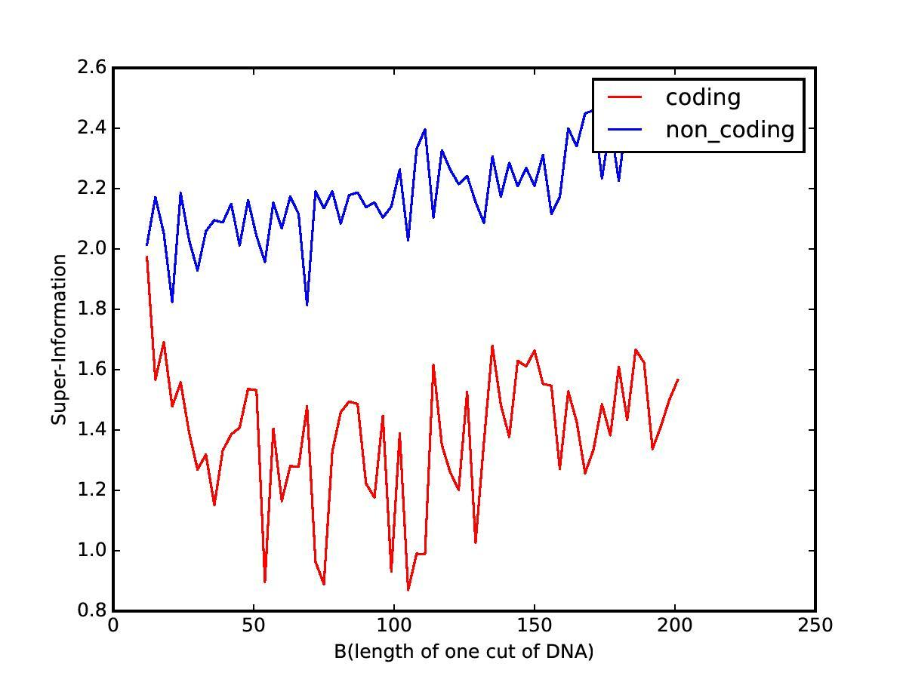
Results
After getting all the coding and non-coding regions and concatenating each in two coding and non-coding sequences, gave us the following Super-Information with increasing B value (NC_000911,NC_002570).

Slide 7
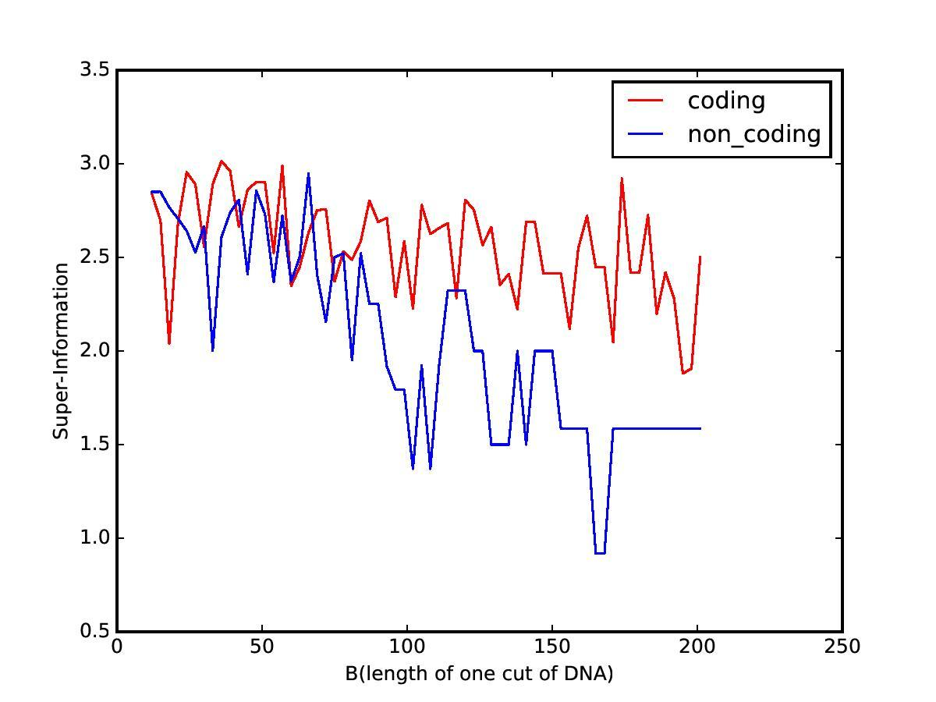
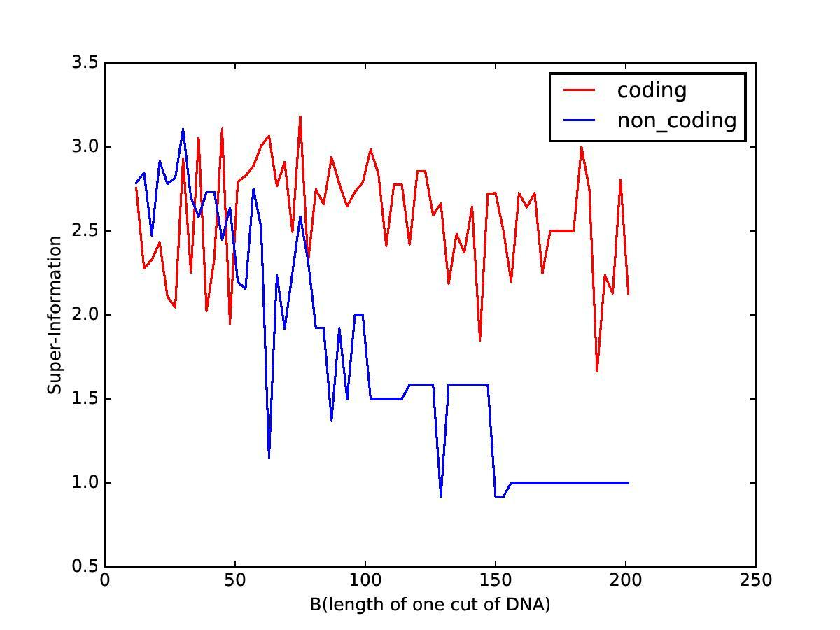
Result
Super-Information of some seperate coding and non-coding regions at different B values out of NC_000911, NC_000915 genome.

Slide 8
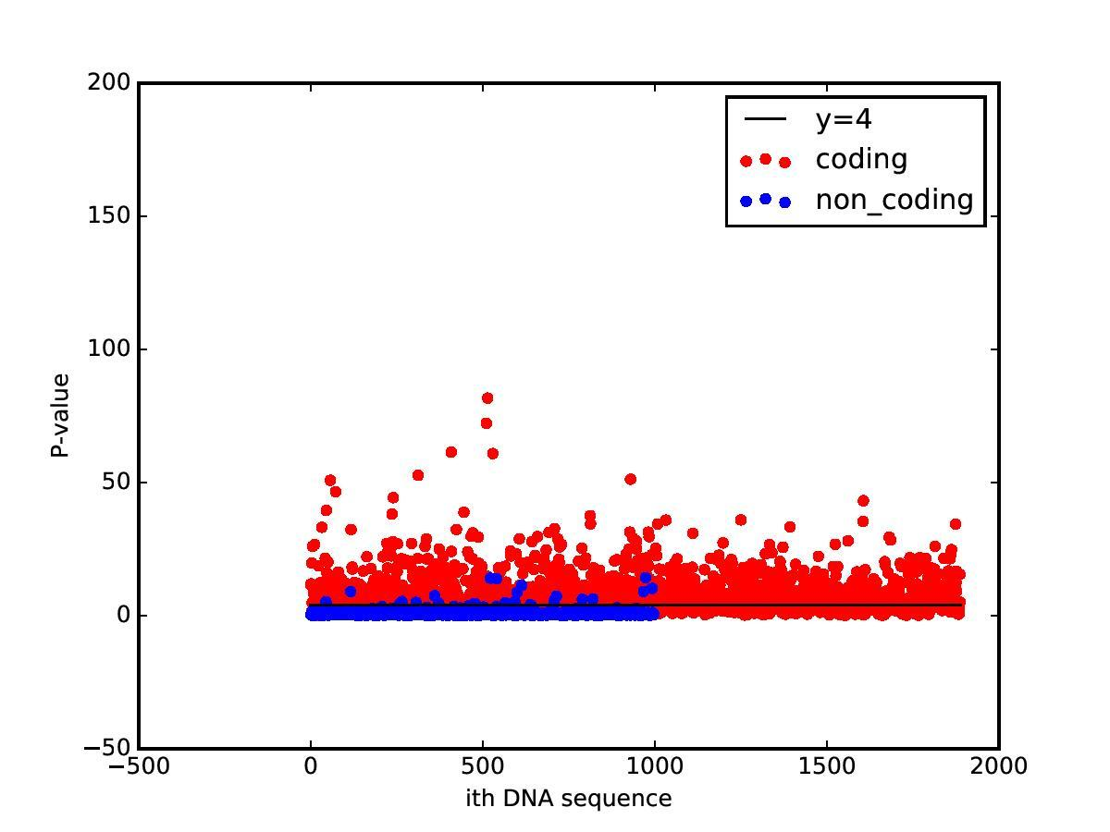
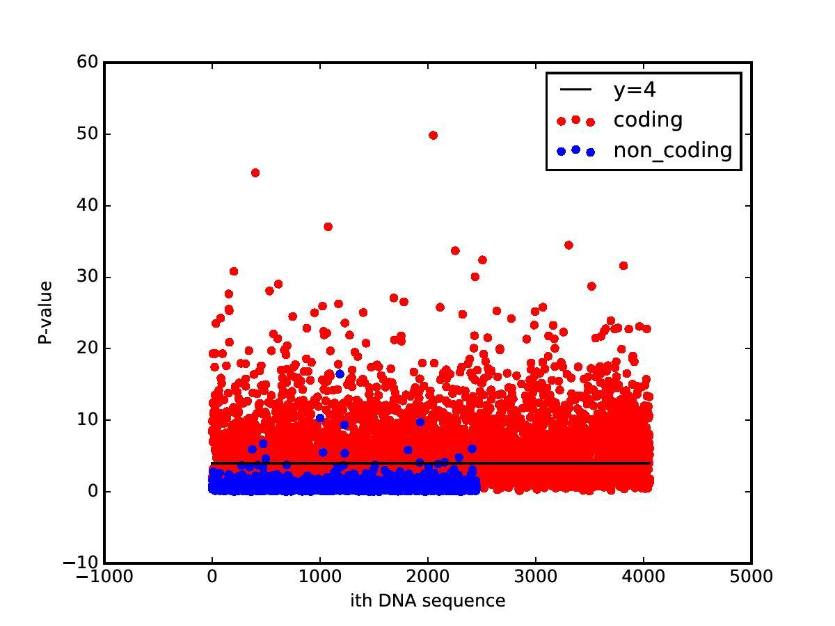
Results
P-value of codons and non-codons sequences in genome. (NC_003098,NC_002570).

Slide 9
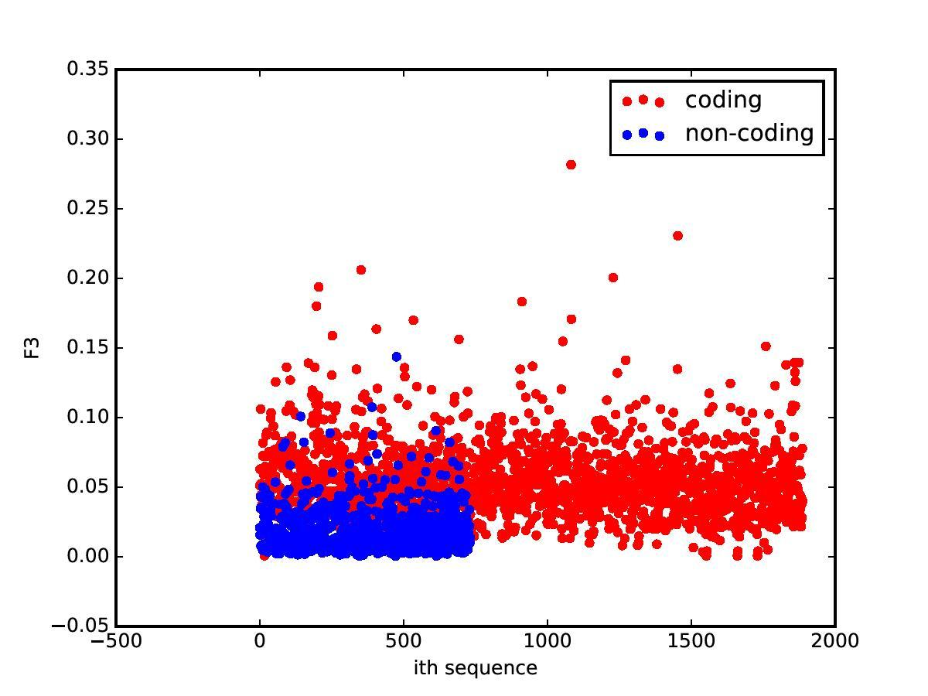
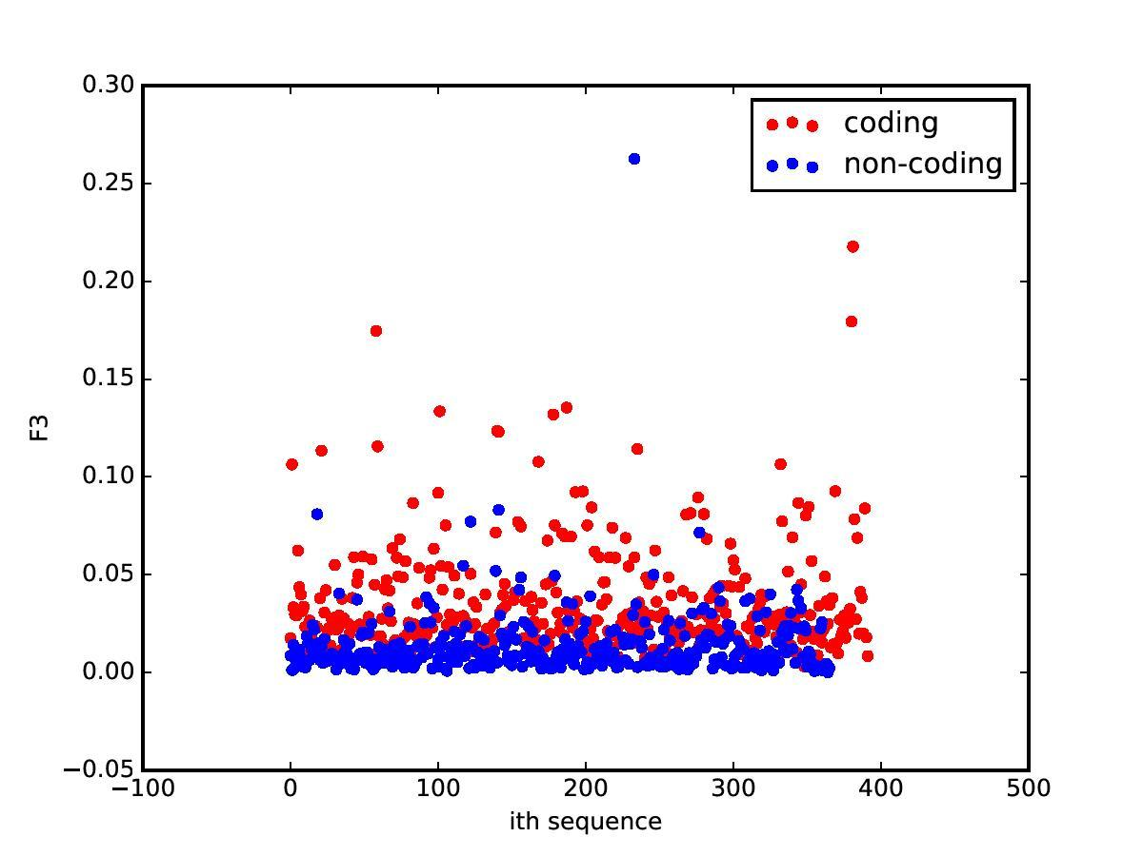
Results
F3 value for codon and non-codons sequence of genome. (NC_003098,NC_001142).

Slide 10
Further analysis by Machine Learning
On getting such interesting results, it would naturally follow to implement this ML algorithm using Neural Networks.
Goal: Classification of Coding and Non-coding region for a given base-pair sequence.
Input features:
P value (Fourier Transform method)
H_{s} value (Super information)
F₃ value*
*[C. Yin and S-T. Yau, A Fourier Characteristic of Coding Sequences: Origins and a Non-Fourier Approximation]

Slide 11
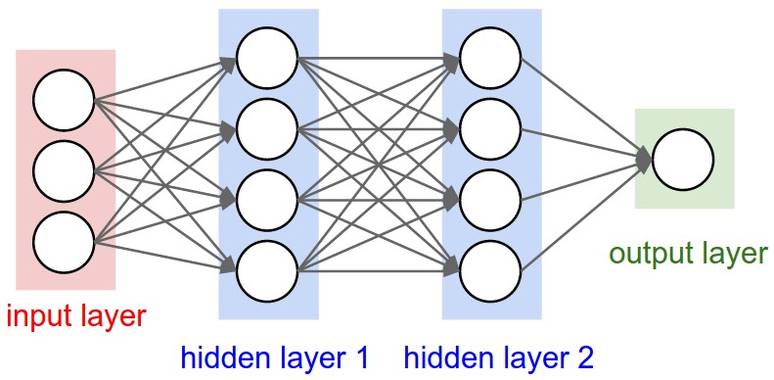
Neural Network Architecture

Slide 12
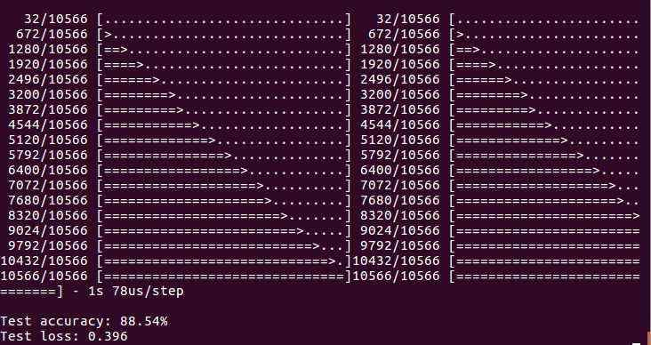
ML using Tensorflow module for Python
We used a backend API in tensorflow called Keras to implement our ML algorithm.
Results:

Slide 13
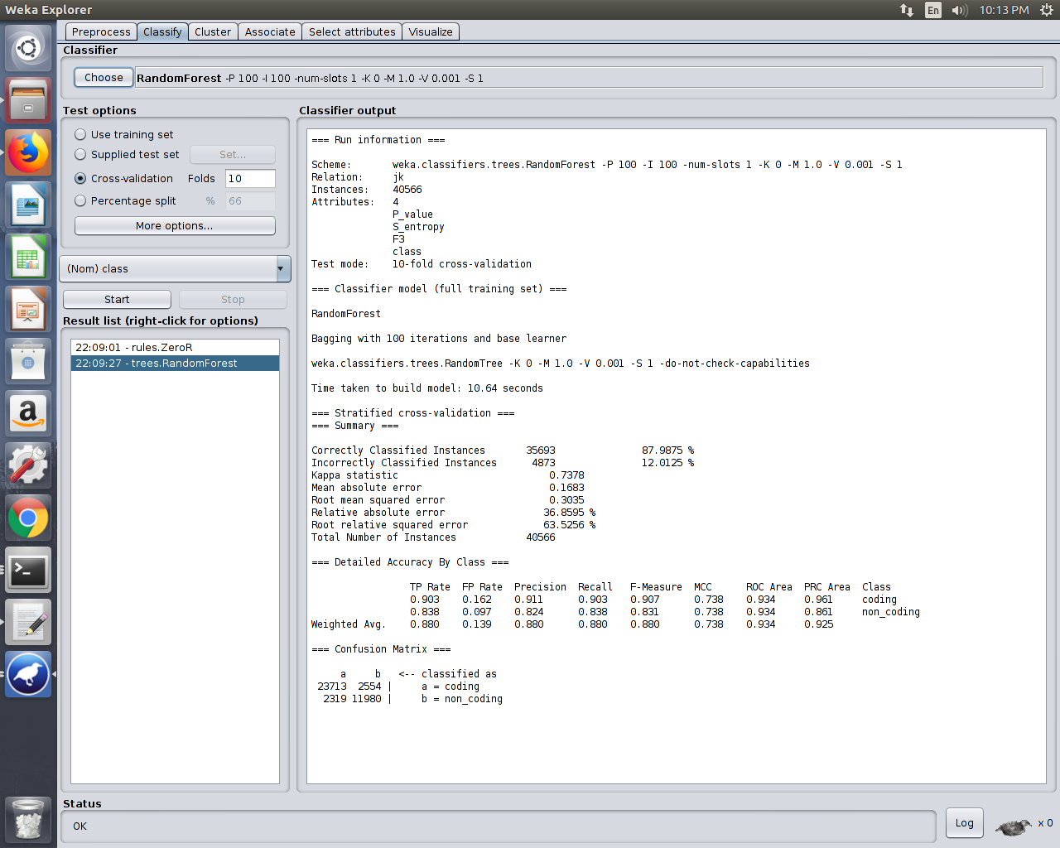
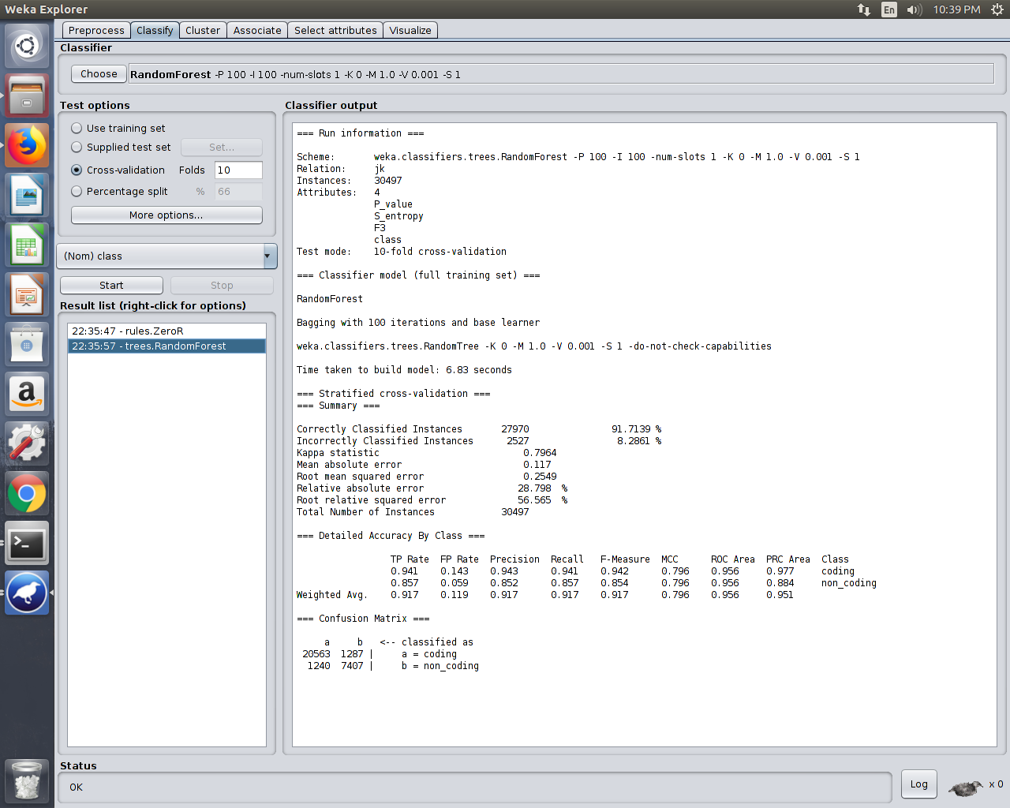
ML using WEKA toolkit
We ran self made .arff file on WEKA toolkit having P-value, Hs ,F3 as Real values and classifiers as coding and non-coding. We have used Random Forest Tree algorithm. We got different accuracy for different B-values{20,50}(different length cut of DNA sequence to get Hs).

Slide 14
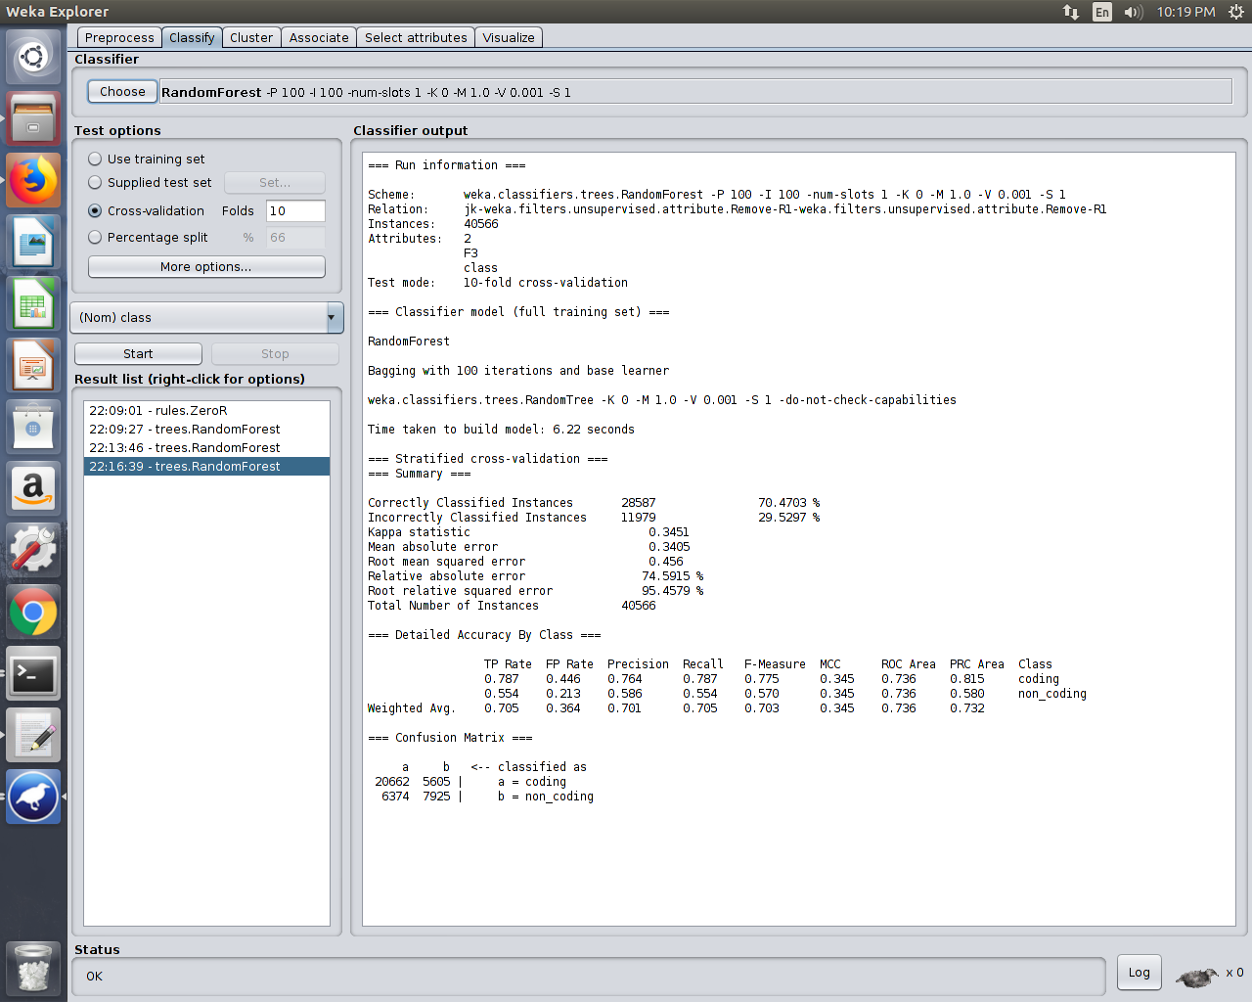
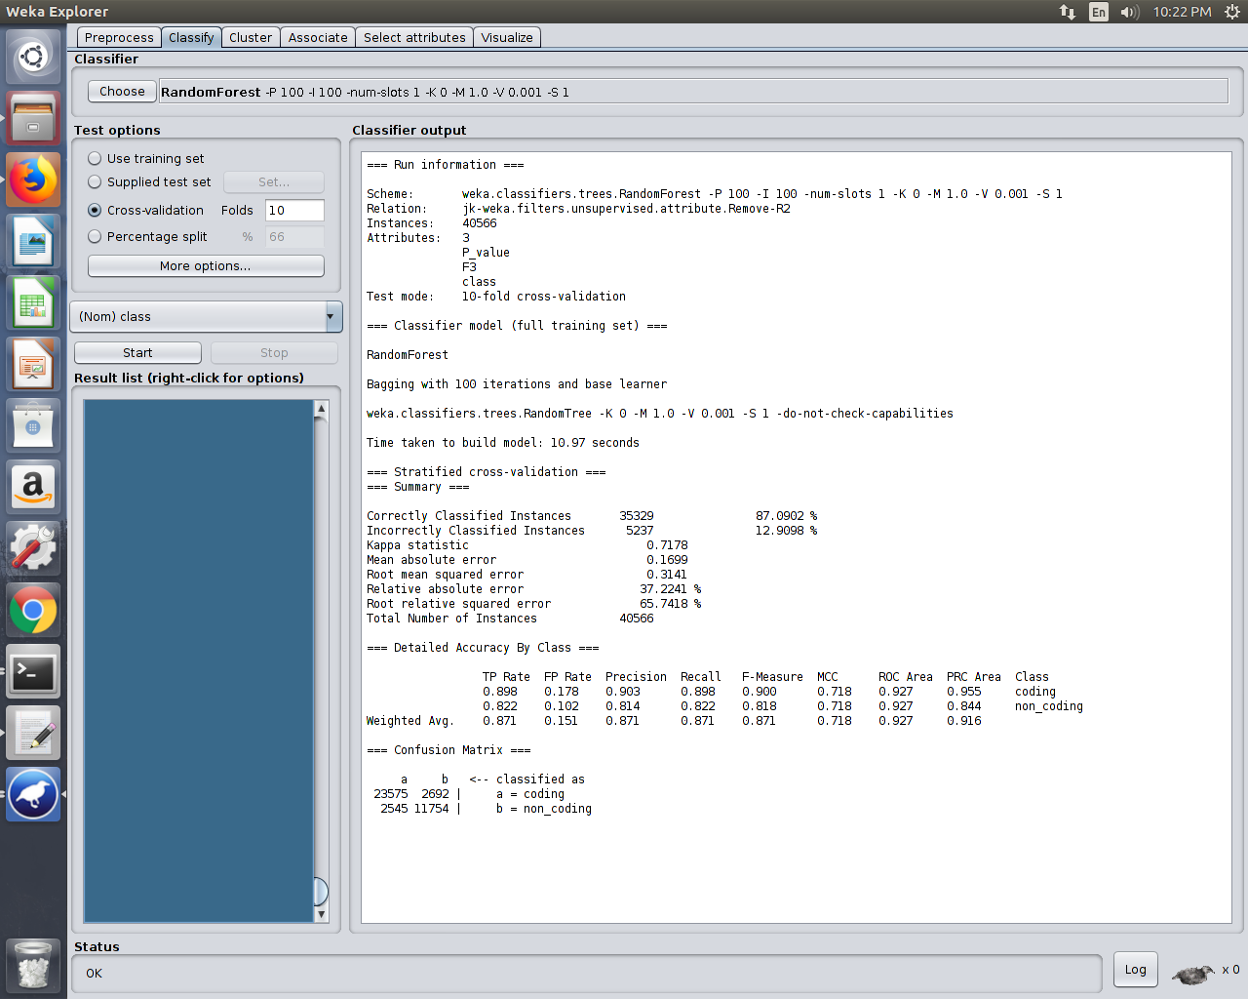
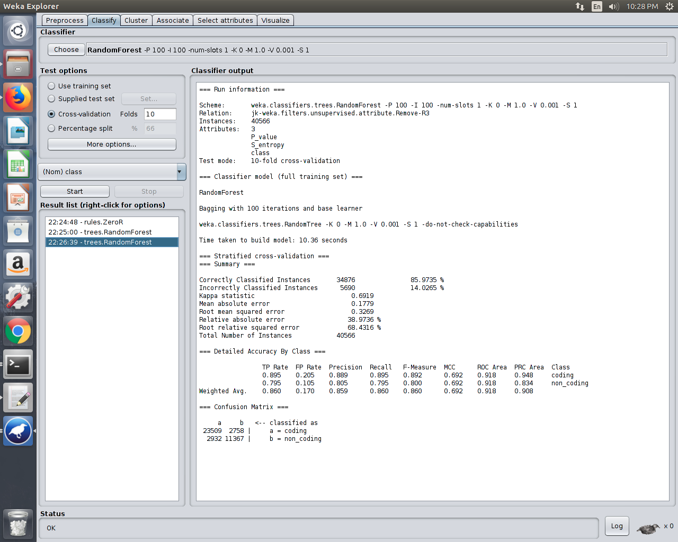
Results
After removing different attributes at B{20}.

Slide 15
Conclusion
We were successful in understanding and replicating the results of Super information as an alternate measure of classifying a DNA sequence as coding/non-coding
We implemented ML classification using Tensorflow having an accuracy of ~88%
Similar implementation was done on WEKA toolkit giving us an accuracy of ~90%
The accuracy can be further increased if we get more input features (measures of Information in DNA).

Slide 16
Future goals
To implement the Super information measurement on Eukaryotic genome sequences.
To finally use data of human chromosomes to get more useful complex results.
Adding enough inputs to improve the Classifier accuracy.

Slide 17
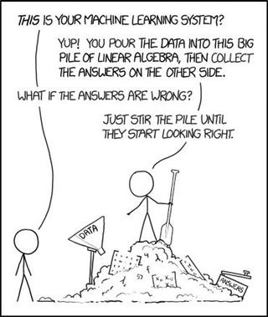
Courtesy: https://xkcd.com/1838/

Slide 18


